Slide 1
Earlier planning, more free beds
WP1 · BUSINESS & CLINICAL CASE · FOR THE BOARD
Finger Lakes Health System · 17 hospitals, Rochester, NY
Data Analysis
UPM · October 2026
Jin fa Zheng · Andrea Brugnera
Notes:
Good morning. We are asking the board to support one decision: start discharge planning on the day a patient is admitted, for the patients most likely to overstay. In our system, days beyond the normal stay for a patient’s condition have almost doubled since 2017. The part above our own pre-COVID level is about 79,700 bed-days a year: 218 beds every day. Over the next slides: the problem, the decision, how we measure it, the evidence, what it returns, the data, and how it will run.

Slide 2



Every day past the normal stay costs money and blocks a bed
1 · CASE AND CONTEXT
The hospital is paid per admission, not per day
FINGER LAKES HEALTH SYSTEM · 17 HOSPITALS
A fixed payment per condition (DRG): a day beyond the normal stay earns nothing.
79,700
The extra day still costs the hospital
avoidable bed-days a year across its 17 hospitals: excess days above its own 2017 rate, or 218 beds every day
Nursing, drugs, and a bed an emergency or surgical patient is waiting for.
Finger Lakes’ excess days per patient are up 78% since 2017, the highest of New York’s 8 regions
Placement starts too late
Patients wait in a hospital bed for a nursing-home place or home care.
Source: NY SPARCS 2017 and 2023, Finger Lakes adult medical-surgical stays. Of 181,460 excess bed-days in 2023, 101,700 would occur even at the 2017 level.
2
Notes:
Three facts frame the problem. First, the hospital is paid per admission: the payment for a pneumonia is the same whether the patient stays 5 days or 9. Second, the extra days still cost nursing time and supplies, and they occupy a bed that the emergency department or the operating theatre needs. Third, the main reason patients overstay is not clinical: they wait for a nursing-home place or home care that is arranged too late. Not every excess day can be avoided, so we count only the days above the system’s own 2017 rate: 79,700 bed-days a year, or 218 beds every day. Compared like for like, excess days per patient have risen 78% since 2017, and the system now has the highest rate of New York’s 8 regions. That touches three P&L lines: cost (unpaid days), revenue (admissions the hospital could not take) and capital (beds it would otherwise have to add).

Slide 3

At admission, decide who gets a case manager on Day 1
2 · THE DECISION
TODAY
PROPOSED
Discharge planning is decided case by case
It usually starts once a delay has already begun
No ranked list: case managers react to whoever is stuck
Every morning, new admissions are ranked by risk of a prolonged stay
The top 30% (about 77 patients a day) get a case manager on Day 1
Nursing-home or home-care placement starts immediately
Who decides
Why this decision
Where to start
Director of Patient Flow, with the Head of Case Management, who assigns case managers
Waiting for post-hospital care drives 3 in 4 excess days, and a placement takes days to arrange
The 4 large Rochester hospitals: 76% of stays, 89% of excess days
3
Notes:
The decision we support is concrete: who gets early discharge planning, and when. Today it happens case by case, usually after a delay has started. We propose a ranked list every morning. The 30% of new admissions most likely to overstay, about 77 patients a day across the system, get a case manager on Day 1, who starts the nursing-home or home-care placement immediately. The decision belongs to the Director of Patient Flow and the Head of Case Management. We would start in the four Rochester hospitals, which carry 89% of the excess days.

Slide 4
One KPI, measured against a fixed ruler
3 · KPI AND BASELINE
HOW IT IS MEASURED
BASELINE · FINGER LAKES 2023
Excess days = max(0, length of stay − P75)
192.8
KPI = 100 × Σ excess days ÷ admissions
P75 = the stay that 75% of similar patients (same diagnosis and severity) finished within, New York State 2017. Fixed for the whole project.
excess bed-days per 100 admissions
Target variable: prolonged stay (yes / no)
24.4% of stays prolonged
6.69-day average stay
94,132 adult medical-surgical stays
Yes when the patient stays longer than their P75 (24.4% of patients in 2023). The morning flag predicts this on Day 1.
Target | Owner | Frequency | Leading indicator
176.9 in year 1 (−8%) | Director of Patient Flow | Daily list, monthly review | % of flagged patients with a plan started within 24 h
Year-1 target = base case on slide 8 (1 day saved per caught stay). Codes created after 2017 use the 2017 ruler for their severity level (7.8% of stays).
4
Notes:
Our KPI is excess bed-days per 100 admissions. For every stay we compare its length with the 75th-percentile stay of patients with the same diagnosis group and severity, in New York State in 2017. Anything beyond that is an excess day. We froze that ruler on purpose: if we recalculated it every year, any improvement would disappear into the new threshold. The 2023 baseline is 192.8 excess days per 100 admissions; 24.4% of stays are prolonged, and that yes/no flag is the target our model will predict. The year-1 target, 176.9, is what the base case on slide 8 delivers. A leading indicator, plans started within 24 hours, tells us early whether the process is working.

Slide 5
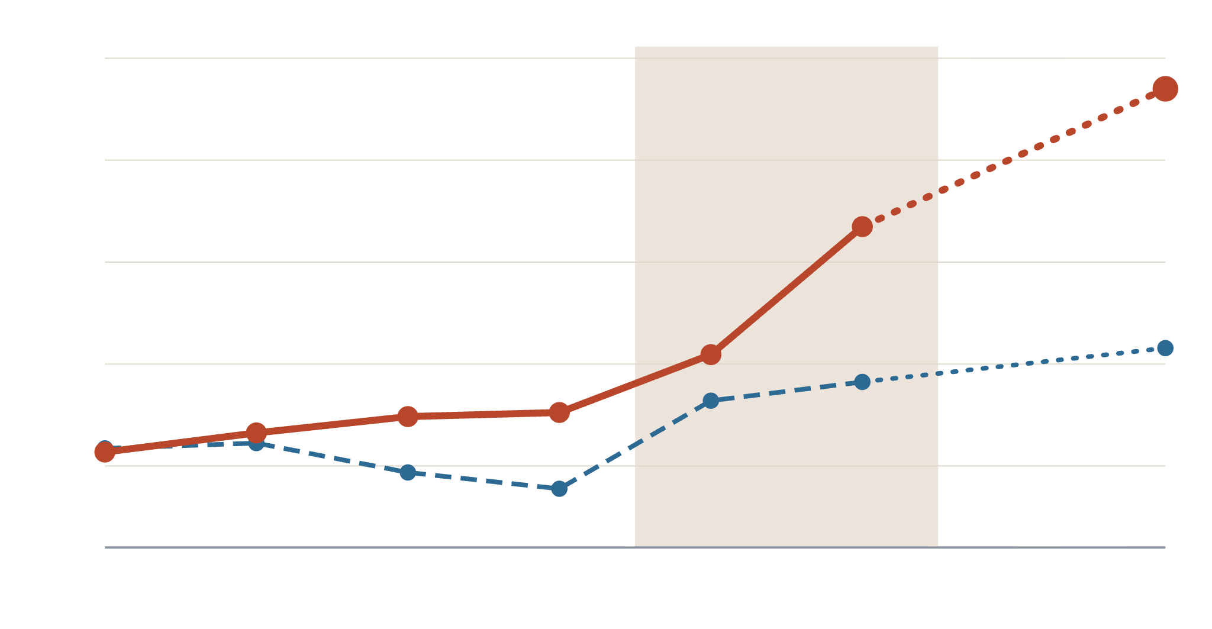
Excess days grew 78% since 2017, the highest rate in New York
4 · EXECUTIVE EDA: IS THE PROBLEM REAL?
192.5
2023 EXCESS BED-DAYS
200
79,700 days
Finger Lakes
Rest of New York
avoidable: above the hospital’s 2017 level
175
158.7
150
101,700 days
expected even at the 2017 level: some patients always need longer
125
128.9
108.1
218
100
COVID-19
2016
2017
2018
2019
2020
2021
(2022)
2023
beds every day taken by the gap, or room for ~11,900 more admissions a year
Excess bed-days per 100 admissions, like for like (codes that existed in 2017). 2022 not downloaded (dotted). Source: NY SPARCS 2016–2023.
5
Notes:
Is the problem real? Before COVID, our system looked like the rest of New York: about 108 excess days per 100 admissions in 2017. Since then it has climbed to 192.5, plus 78%, while the rest of the state rose to 129. We are now the highest of the 8 regions. Not every excess day is avoidable: by definition a quarter of stays run past the 75th-percentile ruler, because some patients always need longer. At the 2017 level that would still be about 101,700 days a year. What the hospital can go after is the gap above that: 79,700 bed-days a year, the equivalent of 218 beds occupied every day, or room for about 11,900 more admissions. This is the cost of doing nothing, and the trend says it is still getting worse.

Slide 6
Three in four excess days wait on care after the hospital
4 · EXECUTIVE EDA: WHERE DO THE DAYS GO?
Of every 100 patients
Of every 100 excess days
57
PATIENTS NEEDING CARE AFTER THE HOSPITAL
39
41 → 75
23
22
25
15
They are 41 of every 100 patients but cause 75 of every 100 excess days
11
4
3
2
Home, no help needed
Nursing home
Home health care
Rehab, long-term care, hospice
Other
Half of nursing-home patients stay too long, 6.6 times more excess days than patients who go home.
How to read it: nursing-home patients are only 15 of every 100 patients, but they cause 39 of every 100 excess days.
Finger Lakes 2023: 94,132 patients, 181,460 excess bed-days. Destination explains the problem; it never predicts.
6
Notes:
Where do the excess days go? For each discharge destination, compare the two columns: blue is the group’s share of patients, orange its share of all excess days. Patients who go straight home are 57 of every 100 patients but cause only 23 of every 100 excess days. Patients who need care after the hospital — a nursing home, home health care, rehab or hospice — are 41 of every 100 patients but cause 75 of every 100 excess days. Nursing-home patients stand out: 15 of every 100 patients, 39 of every 100 excess days; half of them overstay. The data shows where the days are, not why; it cannot tell us when a patient was medically ready. But the pattern is consistent with placement being arranged too late, which is exactly what starting on Day 1 fixes.

Slide 7
What we know at admission already separates high-risk patients
4 · EXECUTIVE EDA: CAN WE ACT ON DAY 1?
Each bar: extra bed-days for every 100 patients admitted in that group. The average for all patients is 193.
How they arrive
Who pays
Age
Urgent
Medicaid · Medicare
50 to 69 · 70 or older
258
212 · 205
206 · 198
Emergency
Private insurance
30 to 49
207
114
158
Planned
Blue Cross / Blue Shield
18 to 29
81
108
143
Urgent and emergency patients have 2.6–3.2 times the extra days of planned patients
Medicare and Medicaid patients are 80 in every 100 admissions but cause 86 in every 100 extra days
Patients aged 50+ are 82 in every 100 admissions but cause 86 in every 100 extra days
Finger Lakes 2023, 94,132 admissions; orange = higher-risk groups. Payer and age overlap, so the model will weigh them together.
7
Notes:
Can we act early enough? Yes: information the hospital has when the patient arrives already separates high- and low-risk patients. Read each bar as “for every 100 patients in this group, this many extra bed-days”; the average across all patients is 193. Urgent and emergency admissions have 2.6 to 3.2 times the extra days of planned admissions, whose recovery is usually arranged in advance. Medicare and Medicaid patients are 80 of every 100 admissions but cause 86 of every 100 extra days; patients over 50 show the same pattern. Payer and age overlap, so the model will weigh them together. Two more findings from the notebook: four Rochester hospitals hold 89% of excess days, and 30 of 272 diagnoses explain more than half of them. Diagnosis and severity are coded at discharge, which is why WP3 tests a strict Day-1 model alongside one that uses the provisional admission diagnosis.

Slide 8
Early planning returns $17.5M net a year
5 · EXPECTED VALUE
$375
$2,359
$200
cash saved per bed-day avoided
gained per freed bed-day used by a new patient
cost per flagged patient
16% of a $2,344 day is variable cost; the rest is fixed
the new admission’s payment, minus its own variable cost
~3 h of case-manager time; 28,240 flags a year = $5.65M
Scenario | Days saved per correctly flagged patient | Freed beds used by new patients | Beds freed daily | Net value a year
Conservative | 0.5 | 25% | 20 | +$1.5M
Base | 1.0 | 50% | 41 | +$17.5M
Optimistic | 1.5 | 75% | 61 | +$42.3M
When it pays for itself
If each correctly flagged patient goes home 1 day earlier (cash savings only), or just 6 hours earlier if half the freed beds go to new patients. Today they stay 7.9 days too long.
Assumes the morning flag finds 65 of every 100 patients who would overstay, while flagging 30 of every 100 admissions (H1, to prove in WP3).
Finger Lakes 2023. Variable share: Roberts et al., JAMA 1999 (84% of hospital costs are fixed).
8
Notes:
What does it return? A saved bed-day is worth money in two ways. In cash, only the variable part of the day disappears: about 16%, or $375 of a $2,344 day, based on a JAMA study showing 84% of hospital costs are fixed. In capacity, a freed bed that is refilled with a new paid admission is worth about $2,359 per bed-day. Early planning costs $200 per flagged patient; flagging 30% of admissions is 28,240 patients and $5.65M a year. If the flag finds 65 of every 100 patients who would overstay — our first hypothesis — and each of them goes home one day earlier, with half the freed beds used by new patients, the net value is $17.5M a year. The conservative case still pays, at $1.5M. The programme pays for itself if each correctly flagged patient goes home one day earlier counting cash only, or just six hours earlier if half the freed beds are used. With a 45% variable-cost share instead of 16%, the base case is $21.6M. Doing nothing costs at least $29.9M a year in cash, and the trend is up.

Slide 9
Public data proves the case; hospital data will run it
6–7 · DATA SOURCES AND HYPOTHESES
What we have
WHAT THE EDA SUGGESTS, WHAT WE WILL PROVE
NY SPARCS: every inpatient stay in New York State. Filtered at the state’s API after reading its schema: 6.2M adult stays (2017–19, 2023).
H1
Day-1 data catches ≥65% of prolonged stays while flagging 30% of admissions · WP3
What is missing
Patient id, admission dates and ward census, the diagnosis at admission, social factors. In production: the hospital’s EHR (WP2).
H2
The need for care after discharge can be predicted at admission · WP3
Privacy and consent
H3
Hospital differences remain after more patient-mix controls: process, not patients · WP3
De-identified at source (age bands, 3-digit zip, no dates): no consent needed.
H4
Starting planning on Day 1 sends flagged patients home at least 1 day earlier, enough to pay for itself · WP4 pilot
EDA code in the appendix: WP1_Executive_EDA_and_Business_Case.ipynb and download_sparcs.py.
9
Notes:
The data. We used New York’s public SPARCS dataset: every inpatient stay in the state. We read its schema first and filtered at the state’s API, keeping 6.2 million adult medical-surgical stays. It is de-identified at source, so no consent is needed. What it lacks — patient ids, dates and ward census, the provisional diagnosis, social factors — is exactly what the hospital’s own systems hold, and WP2 designs that pipeline. Four hypotheses carry the case forward. H1 is the one the money depends on: that Day-1 data can catch at least 65% of prolonged stays while flagging 30% of admissions. H2 and H3 test the cause and the process story. H4 is the real-world test: that starting planning on Day 1 actually sends flagged patients home at least one day earlier, the point where the programme pays for itself. Only a pilot in the hospitals can prove that.

Slide 10

A morning worklist for case managers, reviewed every month
8 · DECISION DELIVERY AND LIFECYCLE
OVERNIGHT
MORNING
BED HUDDLE
MONTHLY · YEARLY
New admissions scored from intake data in the EHR
Ranked list in the case-management worklist
Case manager assigned; placement starts on Day 1
KPI vs. 192.8 and flag accuracy; model retrained yearly, ruler frozen
Risks and how we handle them
Risk | Mitigation
False alarms (13,326 a year) | Already priced in at $200 each
Freed beds not refilled | Value falls toward cash only: break-even 1.0 day
Model drifts after changes | Monthly accuracy check, yearly retraining
10
Notes:
How it reaches the people who decide. Overnight, new admissions are scored from intake data. Each morning the ranked list appears in the case managers’ existing worklist, so nobody opens a new tool. At the morning bed huddle a case manager is assigned and placement starts on Day 1. Every month we review the KPI against the 192.8 baseline, the flag’s accuracy; every year the model is retrained, while the ruler stays frozen so results remain comparable. The main risks — false alarms, beds that are not refilled and drift — are priced in or monitored.

